Slide 1
BMI &BMR and maintainance calorie:-

Slide 2
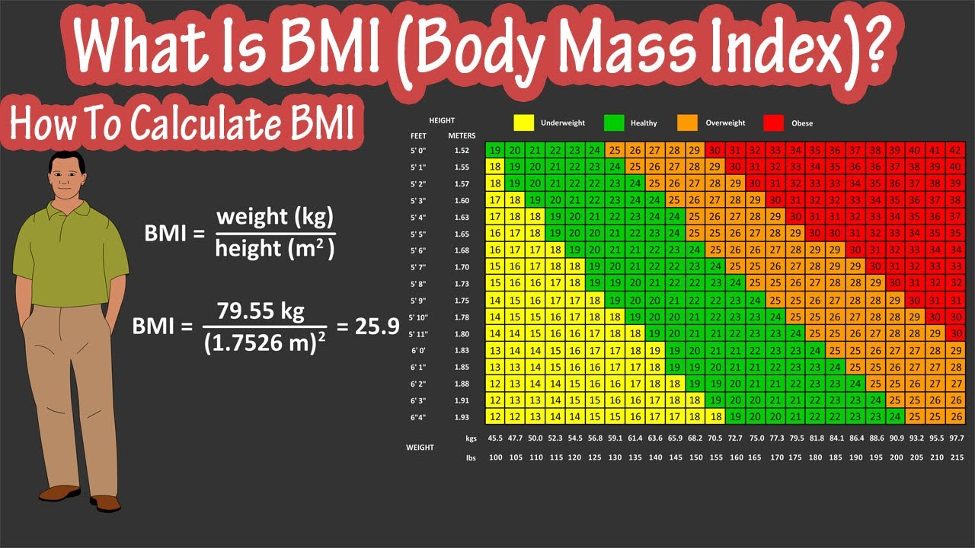
Bmi (Body Mass Index):-
Bmi calculator is important for human as they can measure body shape based on individual’s mass and height.

Slide 3
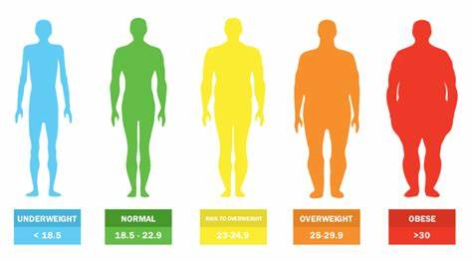
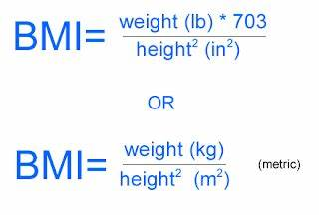
Bmi calculation:-

Slide 4
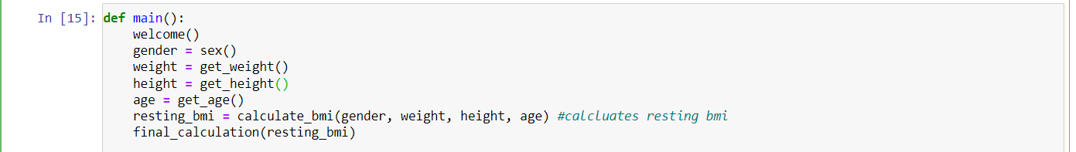
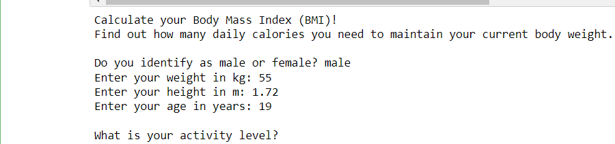
Input output
input

Slide 5

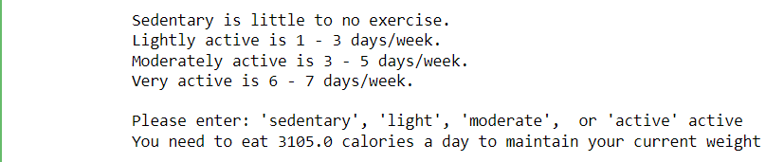



Input output

Slide 6
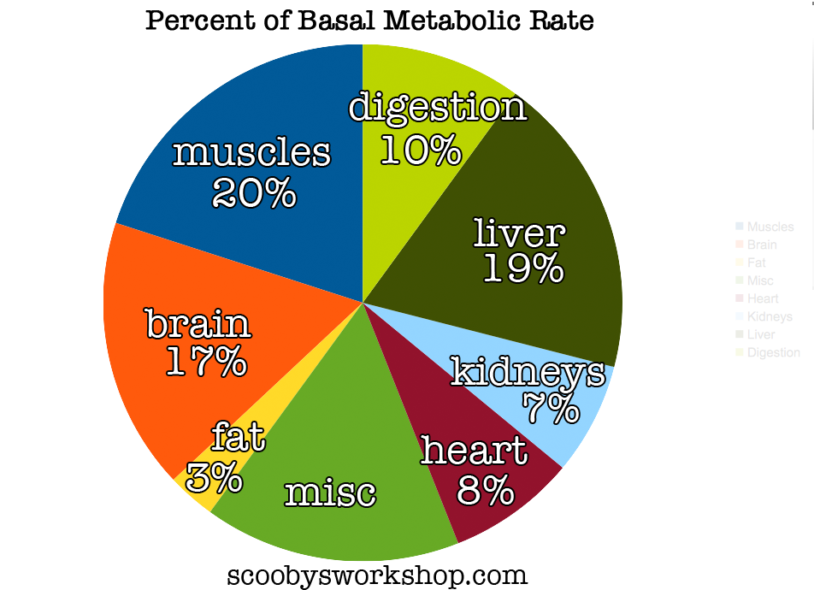
BMR(Basal metabolic rate):-
Bmr is the rate of energy expenditure by human at rest, and is measured in KJ per hour per kg body mass.

Slide 7
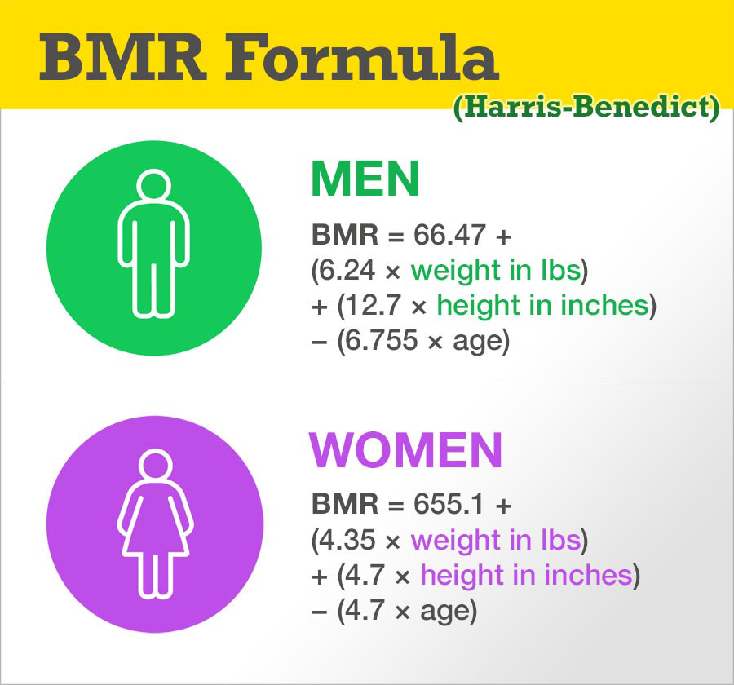
Bmr calculation:-

Slide 8
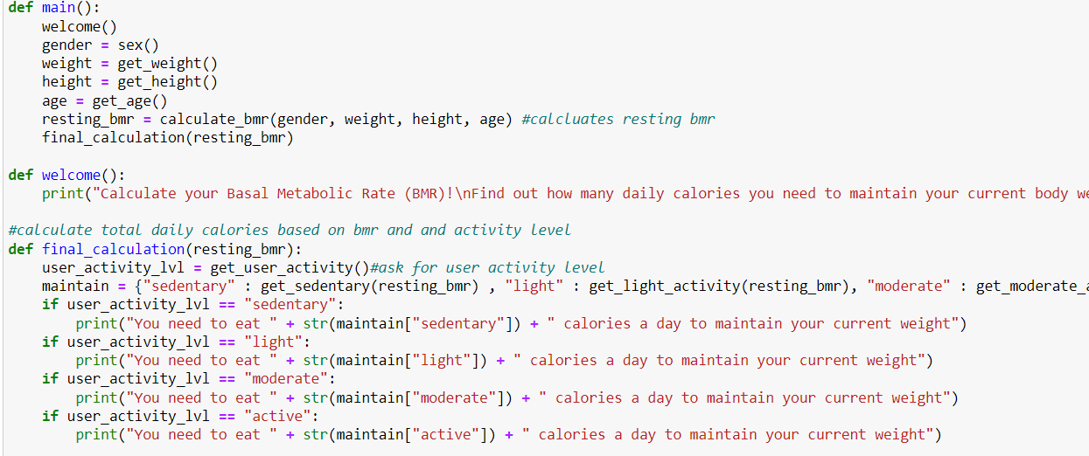
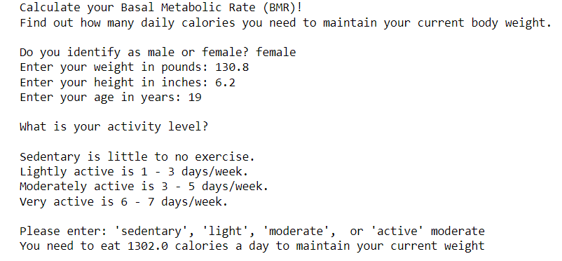
Input output

Slide 9
Rrr
Raj Vardhan Tiwari Rahul singh Rishabh pawah

Slide 10
Thank you

